Slide 1
The Labor force
Wages & Unions

Slide 2
The labor force
The Labor Force is all non-military people who are employed or unemployed.
The various qualifications for employment are as follows:
Must be 16 years old
Worked at least 1 hour for pay in the last week
Worked for 15 hours or more without pay in a family business
Held a job but did not work due to illness, vacation, labor disputes, or bad weather.

Slide 3
Occupational trends
In the beginning American History, the majority of jobs belonged to the farming industry. But as time has gone forward we have transitioned from producing goods to producing services.
For example, we began mostly producing crops and raw materials, then steel and heavy materials for industrialization, and now we mostly provide services such as banking, financial assistance, tech support, or education.
As we have created service based jobs faster than goods based services, we have increased our level of outsourcing.
Outsourcing- Companies contract another company to do a job that would traditionally be done by their own workers.
Offshoring- The movement of a company’s operations to another country.

Slide 4
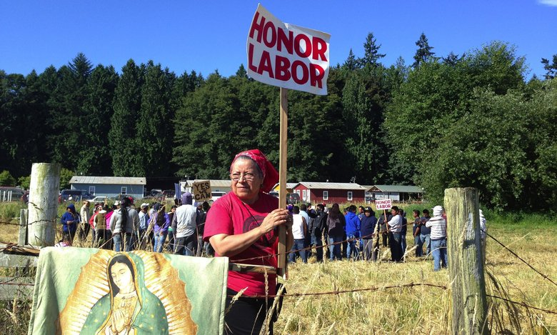
The changing labor force
Increased number of college graduates:
The Learning Effect- Education increases efficiency of production and results in higher wages.
Increased number of women in the workforce.
Increased number of temporary workers:
Businesses are moving away from hiring permanent, full-time workers and toward hiring part-time workers.
Contingent Employment- Temporary and part-time jobs instead of fulltime employment.
Increased number of foreign-born workers:
Guest Workers- Workers allowed to live and work in the U.S. only temporarily.

Slide 5
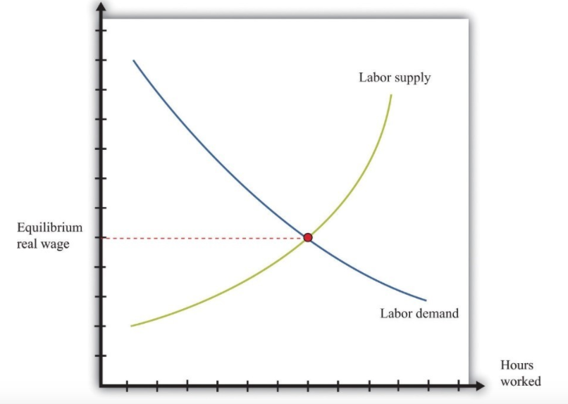
Labor demand
Demand for labor is called derived demand because it is derived by the demand for another good or service.
Example: The demand for cooks depends on the demand for restaurant meals.
Productivity of labor- The quantity of output produced by a unit of labor.
This curve is downward sloping because as wages per hour decreases, so does the number of people who want to work that job.

Slide 6
Labor supply
Labor Supply comes from the number of people willing to work for wages.
This curve is upward sloping because as the wage rate for a job increases, the number of people who want to work that job increases.
The law of supply and demand still apply here, and where the two lines intersect you get the Equilibrium Wage.
Equilibrium Wage- The wage rate set when Supply of Workers = Demand for Work.

Slide 7
Econmovies: Labor Markets

Slide 8
Wages and Worker skills
The Wage Rate you receive as a worker is directly correlated with worker skills and education, as well as the laws of supply and demand.
4 Skill Levels of Jobs:
Unskilled Labor- No specialized skills, education or training.
Example: Janitors, dishwashers, farmworkers
Semi-Skilled Labor- Minimal specialized skills or training.
Example: Lifeguards, truck drivers, equipment operators
Skilled Labor- Requires specialized skill to operate complicated equipment.
Example: Bank tellers, firefighters, carpenters
Professional Labor- Requires advanced skill and education.
Example: Teachers, doctors, lawyers, professional athletes

Slide 9
Wages
In addition to your level of skill, a variety of other factors can impact your wage rate:
Discrimination in the workplace
Women still typically earn lower wages than men.
Minorities still typically earn lower wages than whites.
Minimum Wage Laws
Safety Laws- The more safety regulations imposed on your company, the more your wages are impacted
Unions

Slide 10
Labor Unions
A Labor Union is an organization that tries to improve the working conditions, wages, and benefits of its members.
Unions grew during the 1790’s as worker discontent for working conditions grew.
Workers would go on strike and refuse to work until their demands were met.
As time has gone on, Union membership has declined significantly in the U.S., down to about 8 percent in 2005.

Slide 11
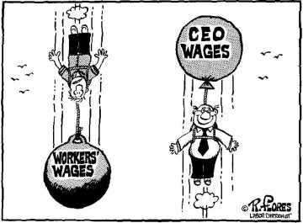
Labor and management
Collective Bargaining- The process in which a union and company management meet to negotiate a new labor contract.
Unions negotiate things like: Wages, Benefits, Working Conditions, and Job Security.
Ultimately if unions cannot successfully negotiate these factors, they still have the ability to go on strike.

